Slide 1
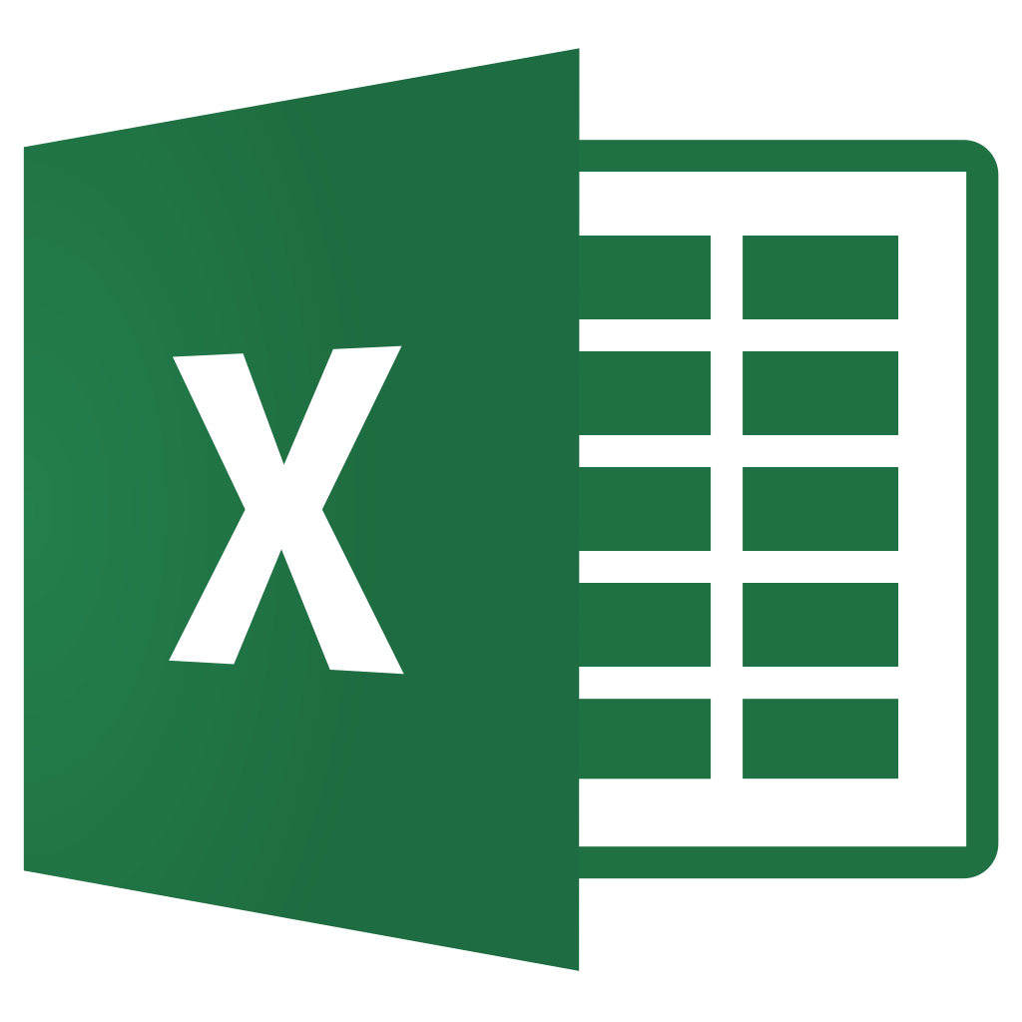

Course Overview

Slide 2
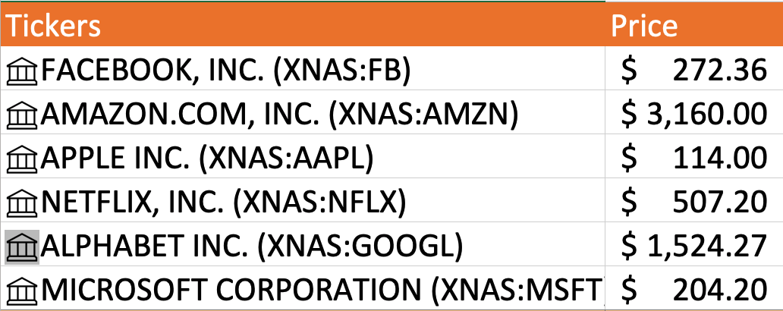
1. Project: Track Stocks in Excel

Slide 3
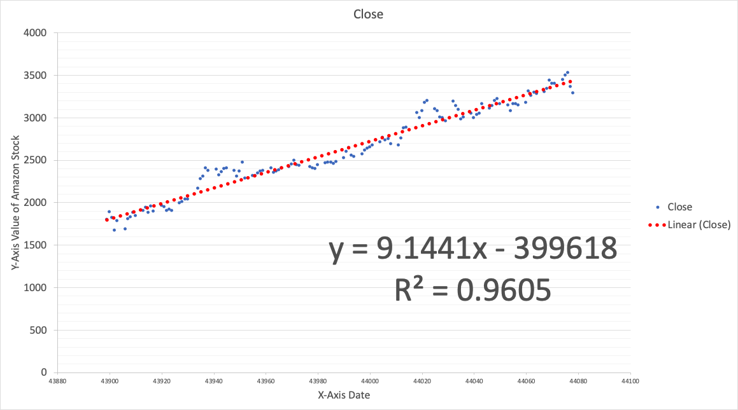
2. Linear Regression on Stock Data in Excel

Slide 4
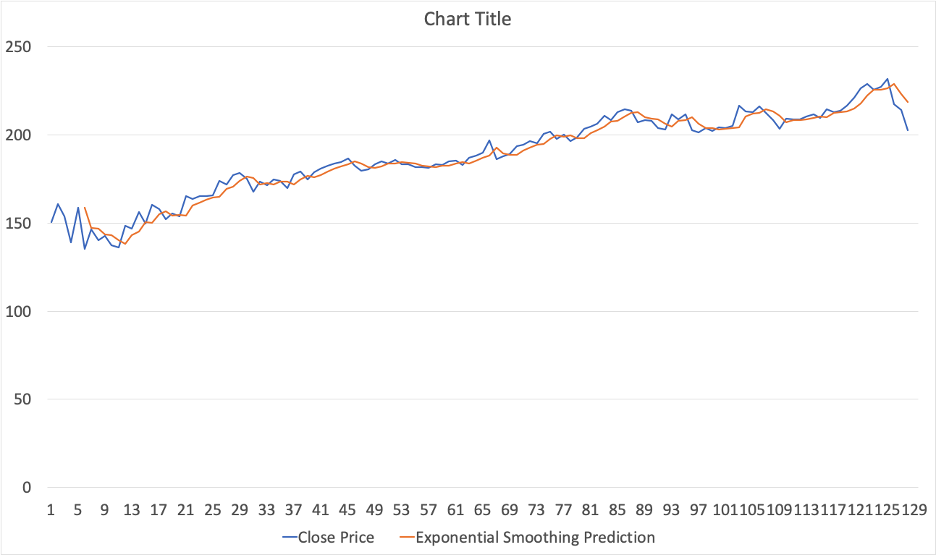
3. Other Techniques of Stock Prediction in Excel

Slide 5
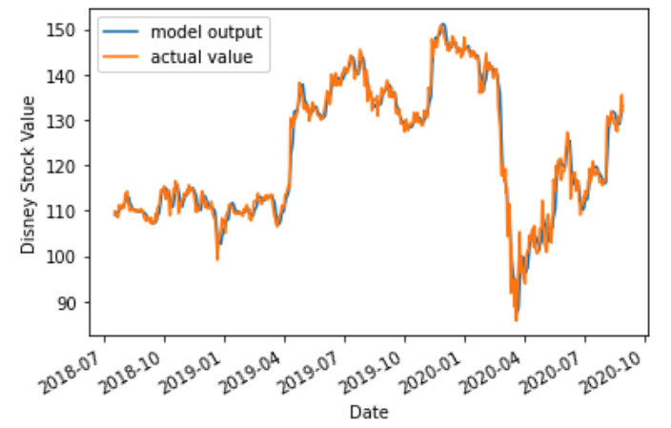
4. Your First Machine Learning Stock Prediction Project

Slide 6





Slide 7
5. Deep Learning Project for Stock Market Prediction
input
output
Neural Network Layer

Slide 8
Course Overview ✓
Let’s begin...

